Slide 1
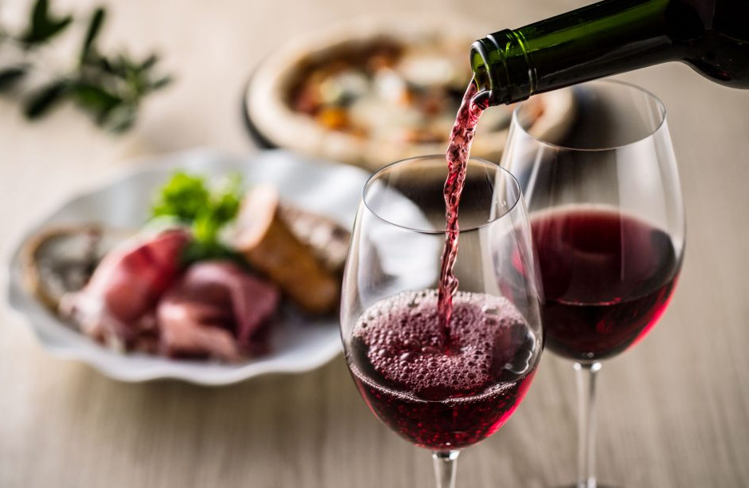
Wonderful Wines of the World
Costumer Segmentation
Francisco Hermenegildo, 20200737
Gil Gonçalves, 20201066
Ikram Bouziri, 20200753

Slide 2

Plan
Database overview
1
Customer Segmentation
2
Segment Profiling
3
General Marketing Strategy
4

Slide 3






Dataset overview
48 years
209 $
10.000
Average age
Average LTV
Customers
32 $
29
Average spending
Features
69.904 $
Average income

Slide 4
Customer Segmentation
Most valuable customers
Customers with high value
Customers with potential
Customers with least potential
2066 customers
2482 customers
2400 customers
3052 customers
Average age
70
687
50
58
254
41
42
26
28
29
-6
16
Avg LTV ($)
Average Spending ($)

Slide 5
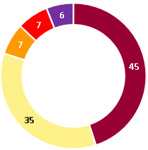
Most Valuable Customers
Buying behaviour
Taste
I’d like the most exquisite wine you have
2% of purchases are made on promotion
19% of purchases are made online
1.418.873$ (67 %) is the value of profit to date from these customers
Makes a purchase every 2,5 Weeks

Slide 6
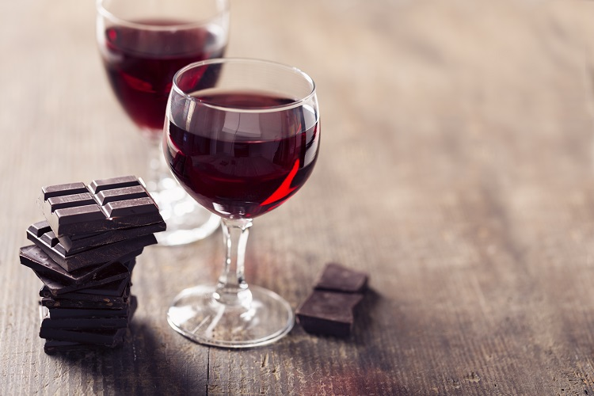
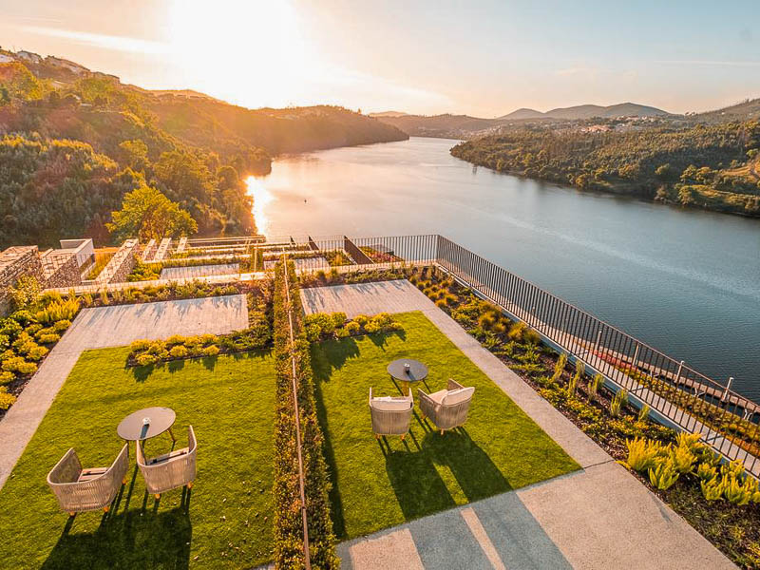
Most Valuable Customers Marketing approach
As this is the best segment, the objective must be to reward and maintain, for that purpose we suggest:
What is the oldest wine you have?
Reward the best customers with chocolates and cheese for each 250$ they spend on WWW
Create and support a top-10 customer reward free tour to a Portugal to taste some of the best wines of the last harvest

Slide 7
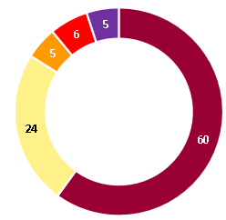
Customers With High Value
Buying behaviour
Taste
I’m not finding my favorite wines!
69% have teens at home
36% of purchases are online
629.390$ (30 %) is the total profit to date from these customers
Makes a purchase every Month

Slide 8
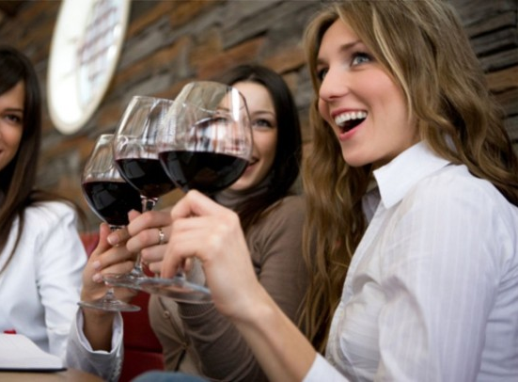
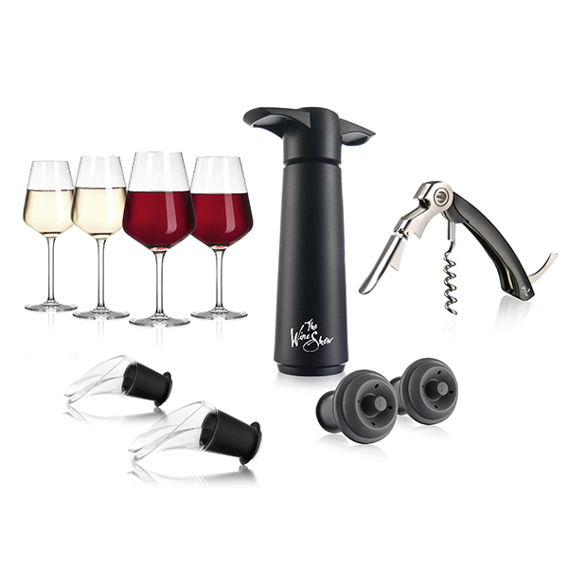
Customers With High Value Marketing approach
My teens are always on the social media!
Run targeted campaigns through social media making preference to sweet wines.
Run small loyalty programs offering:
Cork extractor - annual spending > 500$
Humidifier - annual spending > 600$

Slide 9
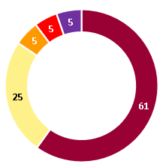
Customers with Potential
Buying behaviour
Taste
I barely have time for myself these days!
37% of purchases are made on promotion
50% of purchases are made online
66% have teens at home
52% have kids at home
61.670$ (3 %) is the value of profit to date from these customers
Makes a purchase each 3 Months

Slide 10
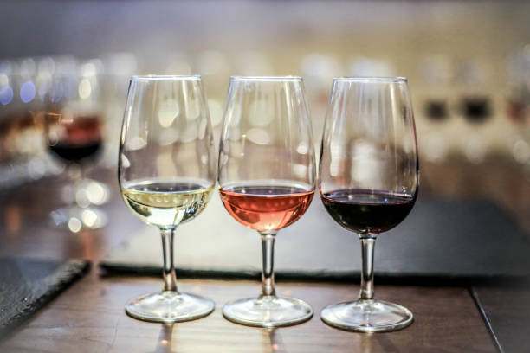
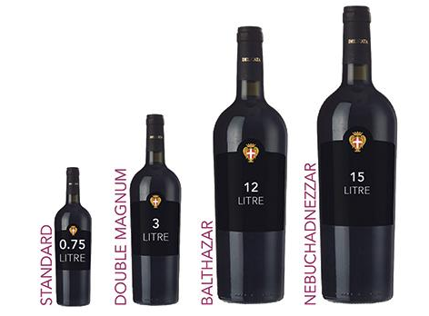
Customers with Potential Marketing approach
Since these are customers that cost us money to keep, we suggest:
I have potential, don’t lose faith on me
Organize free tasting.
Offer tasting packages of sweet wine with each dry wine purchase.​

Slide 11
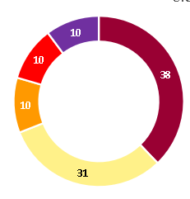
Customers with least potential
Buying behaviour
Taste
Which wines in promotion do you have?
64% of purchases are made are on promotion
57% of purchases are made online
19.218$ (21,6$/day) is the value of loss to date to keep these customers
Makes a purchase each 6 Months

Slide 12
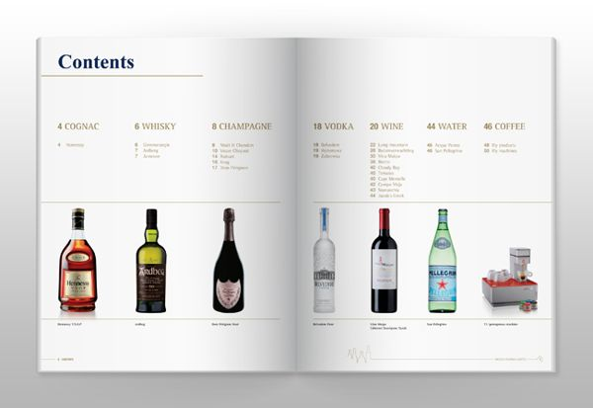
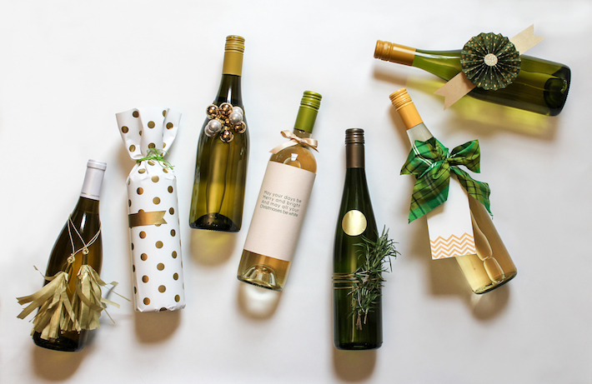
Customers with least potential Marketing approach
For this segment we suggest promoting the Sweet wines as this is the least-buying segment:
Make the catalog e-mail based and offer a discount of 3$ on the next purchase of each customer that subscribes (free) to the digital format (newsletter). In case the customer doesn’t subscribe, stop spending on him.
When are you updating your website?
These customer visit the webpage a lot, most probably looking for a good deal, maybe WWW could hold each week a different promotion deal. Preferably hold an exotic week, each month, since more than 27% of their purchases are exotic wines.

Slide 13
General Marketing Strategy
1
2
3
Make the catalog e-mail based and offer a discount of 3$ on the next purchase of each customer that subscribes (free) to the digital format (newsletter).
Have a page on the website where all the current active promotions are published and keep it up to date
Create wine user guide, explaining the best types according to the different types of food or occasions.

Slide 14


